Slide 1

Lecture
on
“Advanced Computer Architecture –TCS 704”
by
Akansha Gupta
DEPARTMENT OF COMPUTER SCIENCE AND ENGINEERING
GRAPHIC ERA DEEMED TO BE UNIVERSITY – 248002

Slide 2
Cache Performance
&
Cache Mapping

Slide 3
Cache Performance
When the processor needs to read or write a location in main memory, it first checks for a corresponding entry in the cache.
If the processor finds that the memory location is in the cache, a cache hit has occurred and data is read from cache
If the processor does not find the memory location in the cache, a cache miss has occurred. For a cache miss, the cache allocates a new entry and copies in data from main memory, then the request is fulfilled from the contents of the cache.

Slide 4
The performance of cache memory is frequently measured in terms of a quantity called Hit ratio.
Hit ratio = hit / (hit + miss) = no. of hits/total accesses
We can improve Cache performance using higher cache block size, higher associativity, reduce miss rate, reduce miss penalty, and reduce the time to hit in the cache.

Slide 5
Cache Mapping
Cache mapping defines how a block from the main memory is mapped to the cache memory in case of a cache miss.
OR
Cache mapping is a technique by which the contents of main memory are brought into the cache memory.

Slide 6
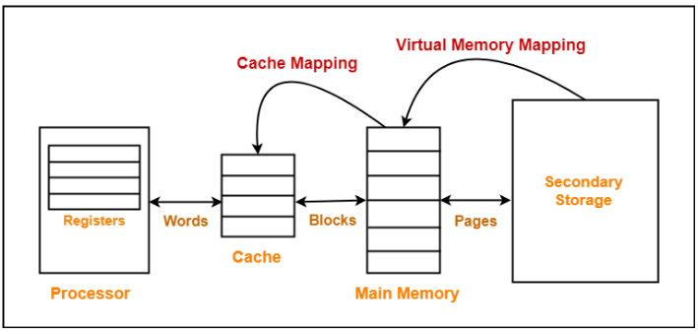
The following diagram illustrates the mapping process-

Slide 7
NOTES
Main memory is divided into equal size partitions called as blocks or frames.
Cache memory is divided into partitions having same size as that of blocks called as lines.
During cache mapping, block of main memory is simply copied to the cache and the block is not actually brought from the main memory.

Slide 8
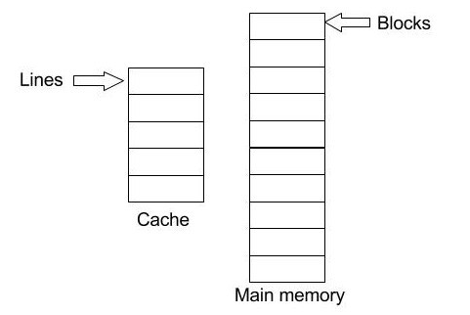
How cache and main memory is conceptually divided
Note: Here is how we divide the main memory into blocks and the size of a block is equal to the size of the cache line.

Slide 9
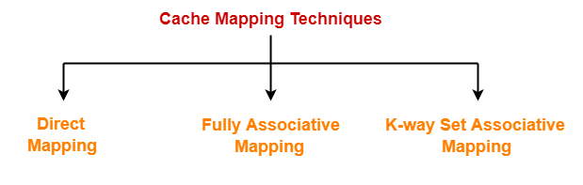
Cache Mapping Techniques
Cache mapping is performed using following three different techniques-
1.Direct Mapping
2.Fully Associative Mapping
3.K-way Set Associative Mapping

Slide 10
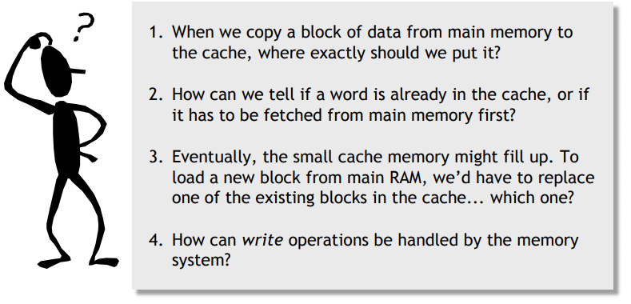
Four important questions

Slide 11
1. Direct Mapping
In direct mapping,
A particular block of main memory can map only to a particular line of the cache.
The line number of cache to which a particular block can map is given by-
Cache line number= ( Main Memory Block Address ) Modulo (Number of lines in Cache)

Slide 12
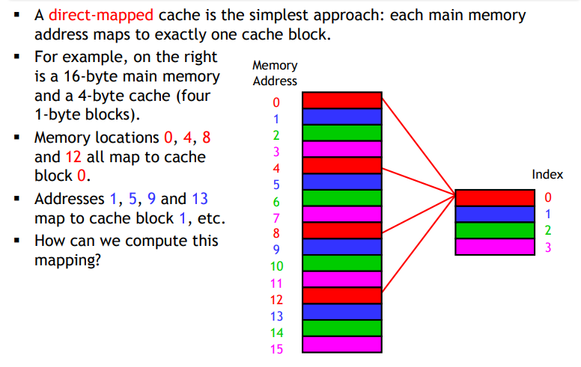
Where should we put data in the cache?

Slide 13
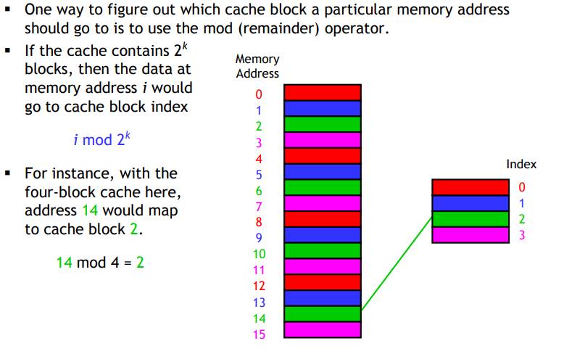
It’s all divisions…

Slide 14
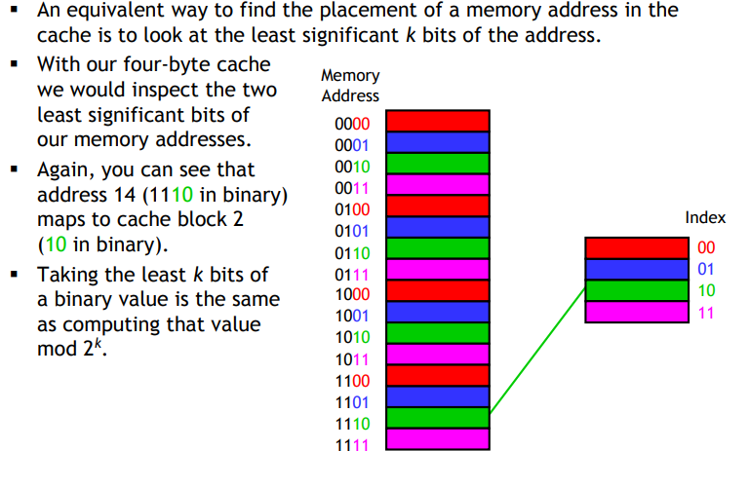
…or least-significant bits

Slide 15
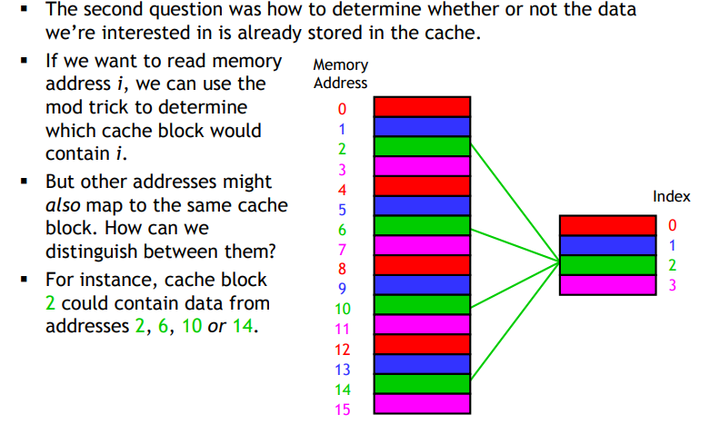
How can we find data in the cache?

Slide 16
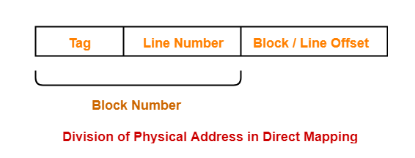
Division of Physical Address
In direct mapping, the physical address is divided as-

Slide 17
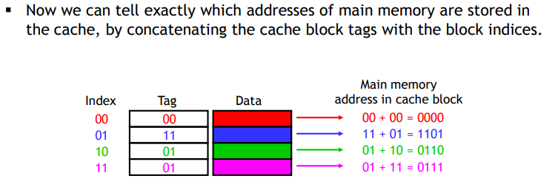
Figuring out what’s in the cache

Slide 18
Need of Replacement Algorithm
In direct mapping,
There is no need of any replacement algorithm.
This is because a main memory block can map only to a particular line of the cache.
Thus, the new incoming block will always replace the existing block (if any) in that particular line.

Slide 19
https://youtu.be/JylDtIK2xX4
THANKS

